Slide 1
Quarterly HR Community Meeting
Human Resources Administration
February 19, 2019

Slide 2
Quarterly HR Community Meeting
AGENDA
February 19, 2019, 10:00am – 12:00pm
DNR Board Room, 12th Floor, East Tower
Welcome and Announcements Al Howell
Results from November 27th Meeting Carla Gracen
Campus Relations Panel Monique Jenkins
                Panel Members
FY2019 Assessment Results Latatia West
Executive Order 01.14.19.02 Al Howell
  Preventing Sexual Harassment in the Executive
  Branch of Government
Meeting Wrap-up Al Howell

Slide 3
Results from November 27th Meeting
Carla Gracen

Slide 4









November 2018 Meeting Recap
“Set the Context”
“Create Hospitable Space”
“Explore Questions That Matter”
“Encourage Everyone’s Contribution”
“Connect Diverse Perspectives”
“Listen Together for Insights”
“Share Collective Discoveries”
“Doodle!”

Slide 5
What We Heard You Say
Give us more advanced notice of meeting dates and agenda
Make it possible to participate remotely in HR Community Meetings
Get to know us (your clients) better
We have many concerns about SHBP and want HRA to help
Provide us with networking and development opportunities
We don’t know many other members of the HR Community
It’s sometimes hard for us to get to meetings
Partner with us in addressing our agency’s needs

Slide 6
What We’re Planning to Do
Offer topics suggested by the HR Community at upcoming meetings
Involve Community members and outside experts as presenters at Community Meetings
Investigate technology for remote meeting participation
Send meeting agenda in advance
Compile and distribute a list of HR Directors
Create an online HR Community Forum
Reinstate the HRA Newsletter
Create/reinstate user groups in different areas of HR
Host HR Director retreat/development event

Slide 7
Campus Relations Panel
Monique Jenkins

Slide 8
Panel Members
Moderator:
  Caroline Anderson
  Assistant Director, Cooperative Education and Internship Program
  University Career Services
  Georgia State University
  Panel Members:
  Brian Nabors
  Manager
  Employment Services
  Department of Natural Resources
  Lt. Crystal Zion
  Recruiting Unit
  Department of Public Safety

Slide 9
FY2019 Assessment Results
Latatia West

Slide 10
FY2019 HR Assessment Results
Participating Agencies:
A total of eight (8) Executive Branch agencies participated in the FY2019 HR Assessment:
  Georgia Department of Early Care and Learning
  Georgia Bureau of Investigation
  Georgia Department of Veterans Service
  Georgia Department of Labor
  Georgia Department of Administrative Services
  Georgia Department of Education
  Employees’ Retirement System of Georgia
  Teachers Retirement System of Georgia

Slide 11
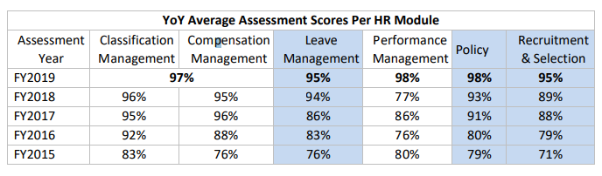
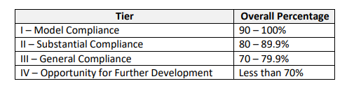
FY2019 HR Assessment Results
Results

Slide 12
Executive Order 01.14.19.02
Preventing Sexual Harassment
Al Howell

Slide 13
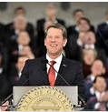
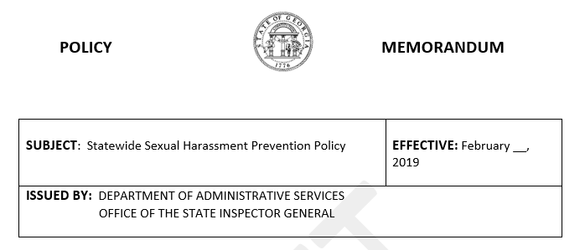




Project Overview
January 14, 2019
Sexual Harassment Prevention
Executive Order
Statewide Policy
Investigation Procedures
Training
Employees
Supervisors &
Managers
Investigators

Slide 14

“Unless someone like you cares a whole awful lot, nothing is going to get better. It is not. And will you succeed? Yes indeed, yes indeed! Ninety-eight and three-quarters percent guaranteed!”
- Dr. Seuss

Slide 15
Meeting Wrap-up
Al Howell

Slide 16
2019 Meeting Dates and Topics
Tuesday, May 21st
Emotional Intellingence for HR Leader
Tuesday, August 20th
Flexible Benefits Update
Tuesday, November 19th
FMLA and ADA

Slide 17
404-463-7054

